Slide 1



Transmission of Viruses in Droplets and Aerosols
Linsey C. Marr
Charles P. Lunsford Professor
Civil and Environmental Engineering
Virginia Tech
20 March 2020

Slide 2
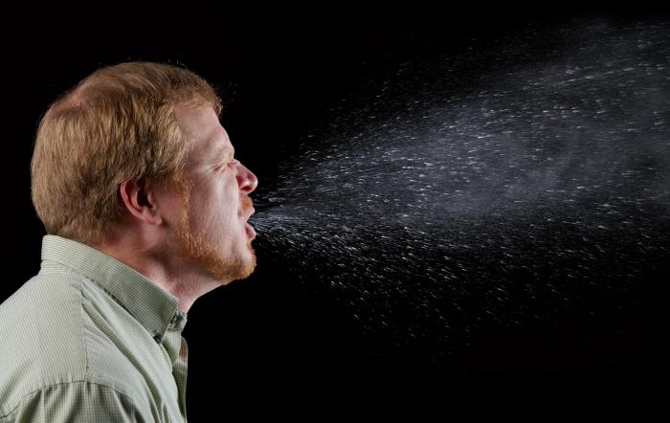
Topics
Respiratory viruses
Transmission modes
Size distributions and evaporation
Virus aerosol dynamics
Impact of temperature and humidity
Masks
SARS-CoV-2
https://phil.cdc.gov/Details.aspx?pid=11160

Slide 3
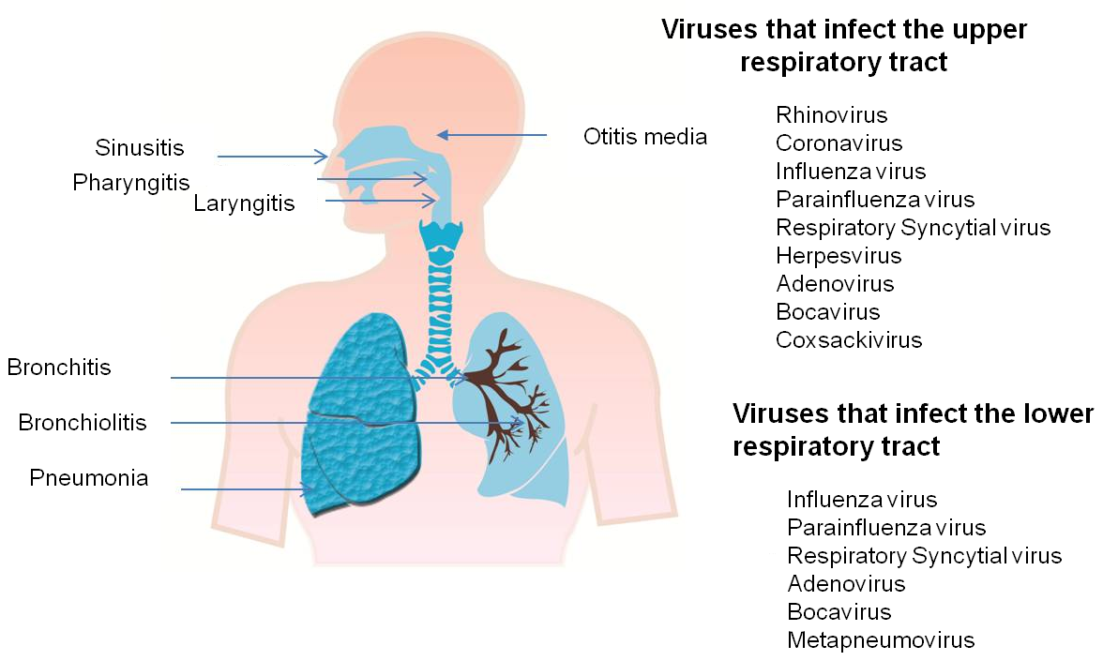
https://www.intechopen.com/books/respiratory-disease-and-infection-a-new-insight/pathogenesis-of-viral-respiratory-infection

Slide 4
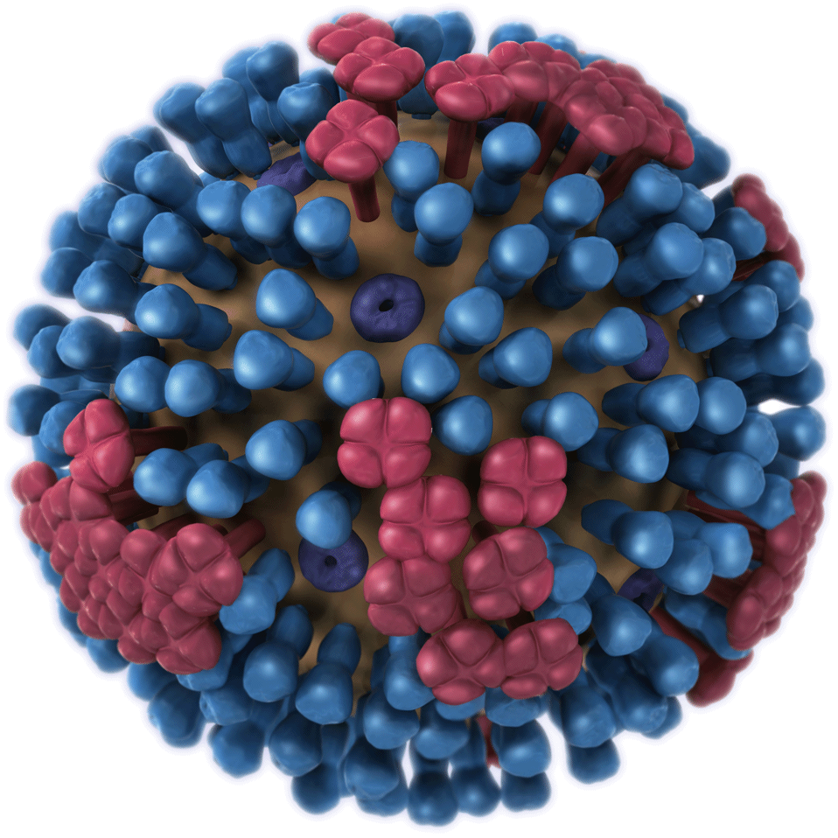
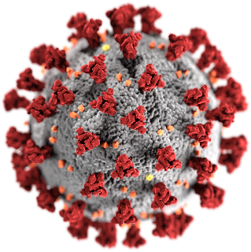
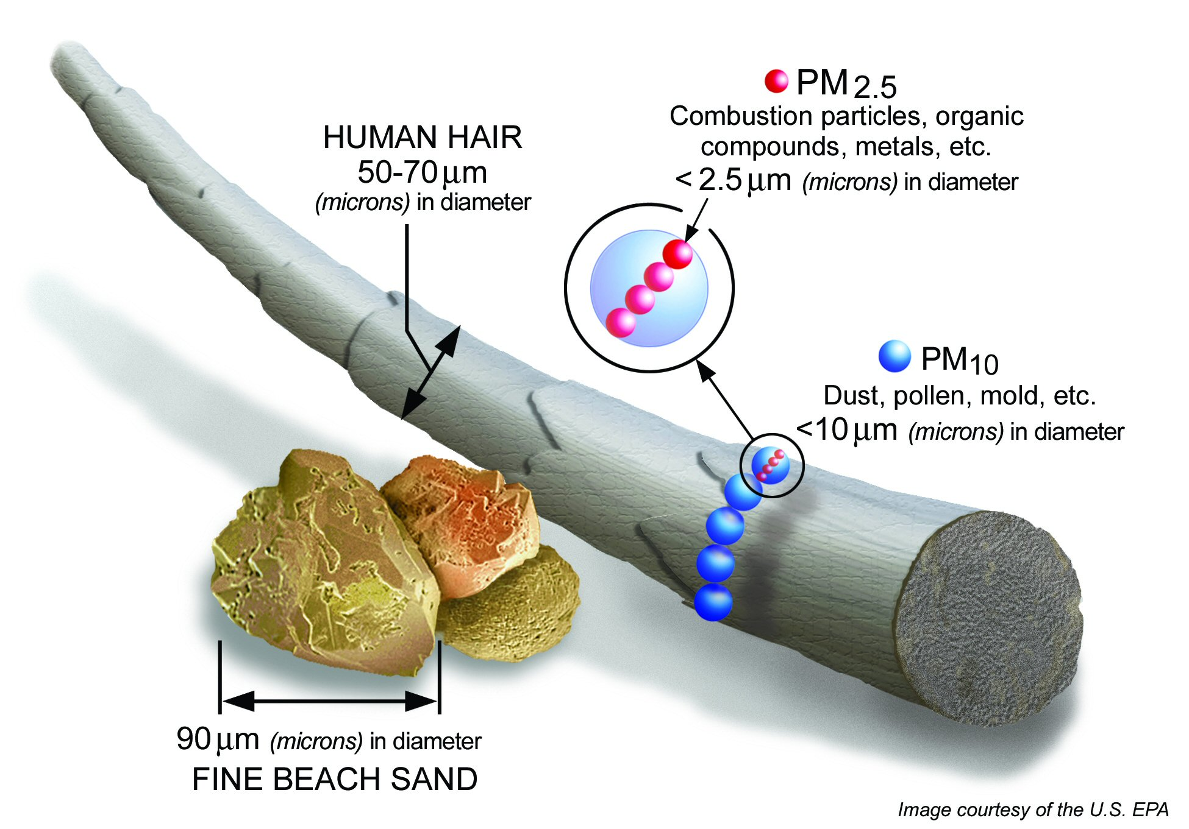
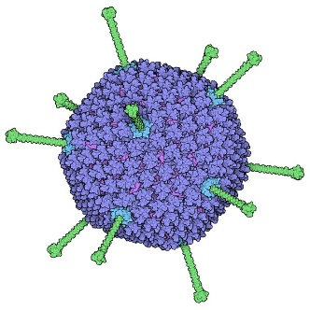
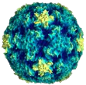
Virus Size
influenza
0.1 μm
SARS-CoV-2
0.12 μm
rhinovirus
0.03 μm
adenovirus
0.1 μm
https://www.cdc.gov/flu/resource-center/freeresources/graphics/images.htm, http://solutionsdesignedforhealthcare.com/rhinovirus, https://phil.cdc.gov/Details.aspx?pid=23312, https://pdb101.rcsb.org/motm/132

Slide 5
Size Matters
respiratory fluid
Airborne virus is not naked!
Size determines
  Lifetime in the atmosphere
  Where it deposits in the respiratory system
0.1 μm
0.5 μm
(0.2-100 μm)

Slide 6




Modes of Transmission
direct contact
indirect contact
Defined by medical community as >5 μm and happening at close-range only (<2 m)
Defined by medical community as <5 μm and happening at long-range only (>2 m)
large droplets
aerosols
http://www.phac-aspc.gc.ca/cpip-pclcpi/annf/v2-eng.php

Slide 7
Reality is More Complicated
Tellier et al., 2019, BMC Infect. Dis, https://bmcinfectdis.biomedcentral.com/articles/10.1186/s12879-019-3707-y

Slide 8
Droplets that are expelled into air can be inhaled, land on people’s mucus membranes, or deposit onto surfaces, where someone can touch them or they can be resuspended into air.
What size are these droplets?

Slide 9
Size Distributions: Breathing
Measured by aerodynamic particle sizer over the range 0.3-20 μm
0.1 1 10 100
Diameter (μm)
Johnson et al., 2011, J. Aerosol Sci., https://www.sciencedirect.com/science/article/pii/S0021850211001200

Slide 10
Size Distributions: Speaking
Measured by aerodynamic particle sizer over the range 0.3-20 μm
0.1 1 10 100
Diameter (μm)
Johnson et al., 2011, J. Aerosol Sci., https://www.sciencedirect.com/science/article/pii/S0021850211001200

Slide 11
Size Distributions: Coughing
Measured by aerodynamic particle sizer over the range 0.3-20 μm
Johnson et al., 2011, J. Aerosol Sci., https://www.sciencedirect.com/science/article/pii/S0021850211001200

Slide 12
Corrected Size Distributions
Speaking
Inferred number concentration in upper respiratory tract
Measured by droplet deposition analysis over the range 20-2000 μm
Coughing
Johnson et al., 2011, J. Aerosol Sci., https://www.sciencedirect.com/science/article/pii/S0021850211001200
Notes:
Note the log scale on the y-axis. There are orders of magnitude more droplets/aerosols <10 microns than >10 microns. However, volume of the droplets/aerosols scales with diameter cubed, so there is more volume in the larger droplets.

Slide 13
Breathing, talking, and coughing release droplets that range from submicron to millimeter in size.
What size droplets carry viruses?

Slide 14
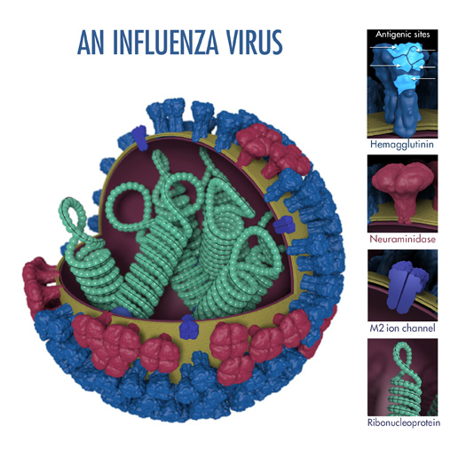
Virus Detection Methods
Total virus
  Number of genome copies (GC) determined by molecular techniques (quantitative polymerase chain reaction, qPCR)
  Reflects number of viruses with intact DNA or RNA
  Does NOT indicate whether virus is infectious or not
RNA is wrapped around the ribonucleoprotein
https://www.cdc.gov/flu/resource-center/freeresources/graphics/images.htm

Slide 15
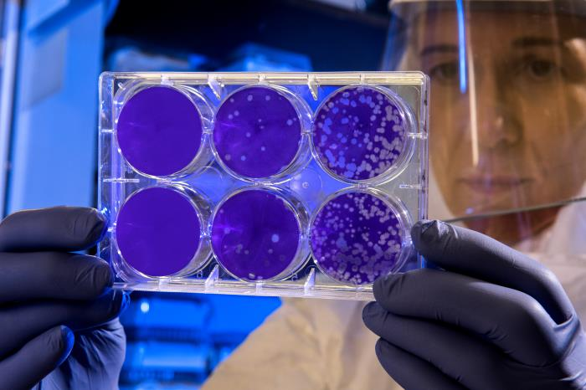
Virus Detection Methods
Infectious virus
  Number of viruses that are able
  to infect cells determined by
  culture (growing)
  PFU = plaque forming units,
  number of viruses capable of
  forming plaques on host cells,
  focus forming units (FFU) are
  related
  TCID₅₀ = median tissue culture infectious dose, concentration at which half of cells are infected after being exposed to the sample
https://phil.cdc.gov/Details.aspx?pid=23213

Slide 16
Relationship Between the Two Methods for Flu Virus
There is a weak, but significant, correlation between virus RNA copies and infectious virus.
Yan et al., 2018, PNAS, https://www.ncbi.nlm.nih.gov/pubmed/29348203

Slide 17
Amount of Flu Virus in Coarse vs. Fine Droplets (Particles) in Exhaled Breath
Milton et al., 2013, PLoS Pathogens, https://www.ncbi.nlm.nih.gov/pubmed/23505369

Slide 18
Flu Virus in Droplets (Aerosols)
coarse aerosols > 5 μm
fine aerosols < 5 μm
30-min sample
recite alphabet at 5, 15, 25 min
Yan et al., 2018, PNAS, https://www.ncbi.nlm.nih.gov/pubmed/29348203

Slide 19
The majority of flu virus (RNA copies) is found in fine (<5 μm), rather than coarse (>5 μm), droplets/aerosols.
How do these droplets move around the indoor environment?

Slide 20
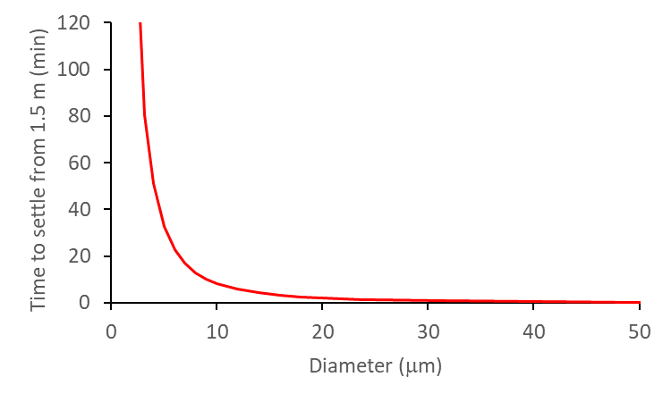
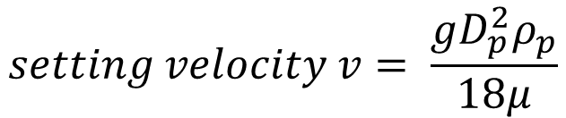
Settling Velocity and Time
particle diameter
particle density
$$setting velocity v= \frac{gD_{p}^{2}ρ_{p}}{18μ}$$
dynamic viscosity of air
Droplets smaller than 10 μm can remain suspended for many minutes

Slide 21
Humidity Controls Final Size
10 μm
evaporation
4 μm
Kohler equation applied to a droplet containing physiological levels of NaCl and protein
Mikhailov, 2004, Atmos. Chem. Phys., https://www.atmos-chem-phys.net/4/323/2004/
Notes:
Separate solute volume additivity (SS-VA) model from Mikhailov et al. 2004, assuming 150 mM (8.8 g/L) NaCl to represent the inorganic
components and 76 g/L of total proteins (TP). n_{s} = moles of solute

Slide 22

Virus Dynamics in Indoor Air
ventilation (air-exchange)
Settling velocity v depends on diameter d
Diameter depends on RH
Inactivation rate k depends on RH
settling
inactivation
ventilation
inactivation
H
concentration of infectious virus in aerosols of diameter d
settling
relative humidity (RH)
Yang and Marr, 2011, PLoS One, https://www.ncbi.nlm.nih.gov/pmc/articles/PMC3123350/

Slide 23
Virus Viability vs. RH
virus decays less (survives better) at low RH
virus decays more at high RH (y-axis is upside down)
Yang and Marr, 2011, PLoS One, https://www.ncbi.nlm.nih.gov/pmc/articles/PMC3123350/
Notes:
Seasonality

Slide 24
Virus-Aerosols From a Cough
evaporation and gravitational settling
There is a size shift due to loss of larger droplets by gravitational settling.
Yang and Marr, 2011, PLoS One, https://www.ncbi.nlm.nih.gov/pmc/articles/PMC3123350/
Notes:
Initial size distribution from log-normal fit to Duguid’s (1946) measurements with GM = 12 um.

Slide 25
Infectious Concentrations vs. RH
Concentrations are higher at lower RH mainly because lab-determined inactivation rate is lower.
Yang and Marr, 2011, PLoS One, https://www.ncbi.nlm.nih.gov/pmc/articles/PMC3123350/
Notes:
Initial size distribution from log-normal fit to Duguid’s (1946) measurements with GM = 12 um.

Slide 26
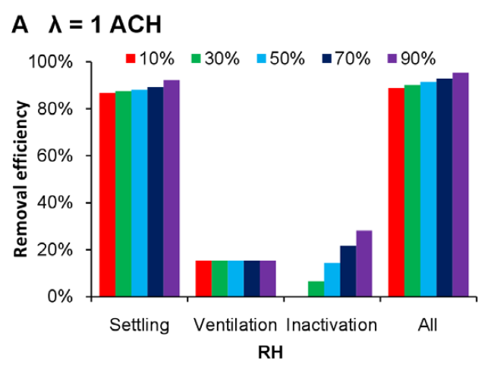
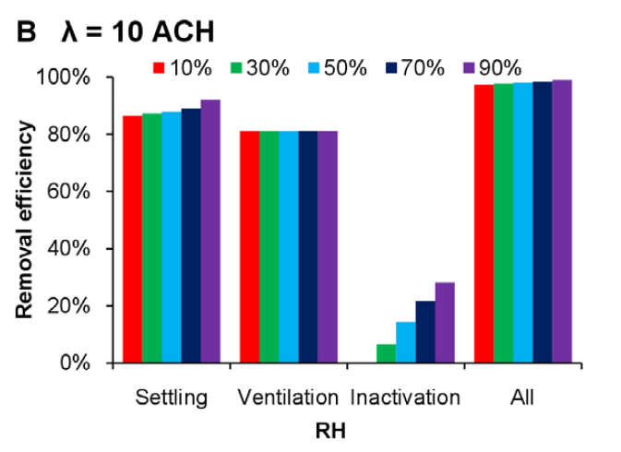
RH and Removal Mechanisms
Settling: main removal mechanism, efficient for large but not small droplets
Ventilation: effective for all sizes, important in public places
Inactivation: effective for all sizes, important for small droplets
Yang and Marr, 2011, PLoS One, https://www.ncbi.nlm.nih.gov/pmc/articles/PMC3123350/

Slide 27
Viruses can be removed from indoor air by settling, ventilation, and inactivation; some of these processes depend on humidity.
How do temperature and humidity affect transmission?

Slide 28
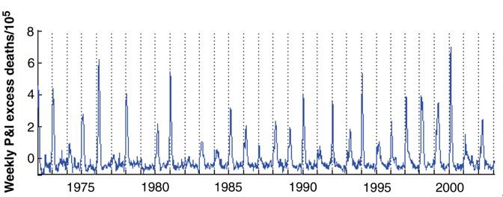
Seasonality of the Flu
Viboud et al., 2006, Science, https://science.sciencemag.org/content/312/5772/447

Slide 29
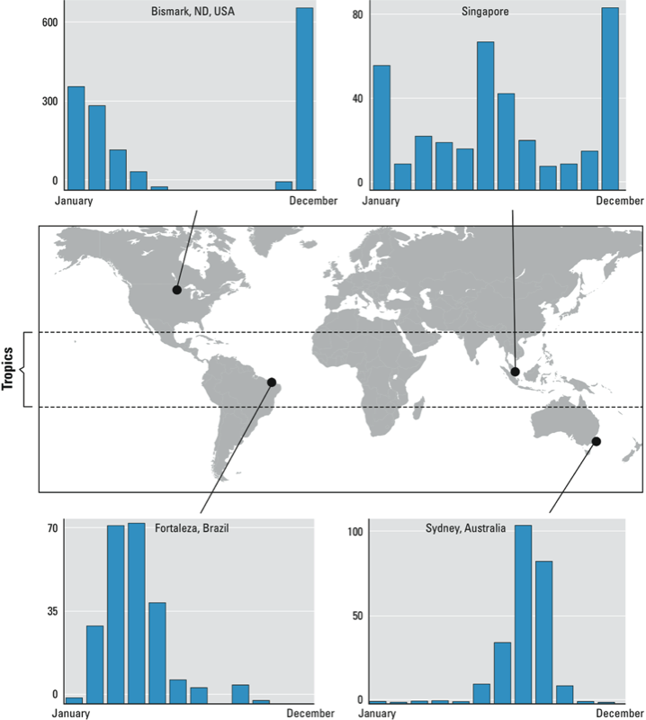
Tamerius et al., 2011, EHP, https://ehp.niehs.nih.gov/doi/10.1289/ehp.1002383
Notes:
RH over the year

Slide 30

https://www.eurekalert.org/pub_releases/2018-10/f-lft100118.php

Slide 31
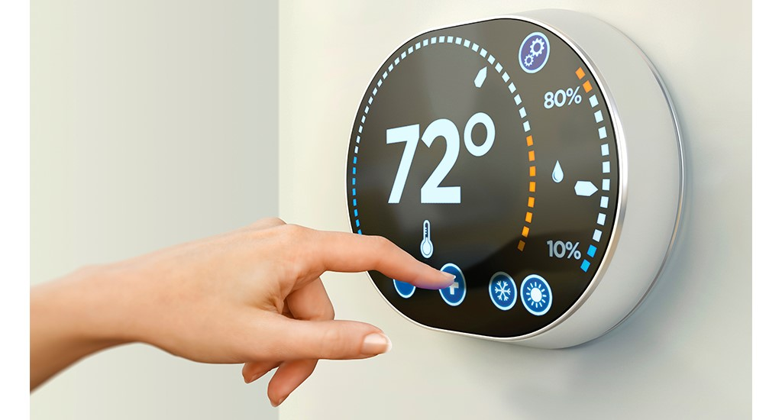
Virus Viability
Temperature (T): In general, viruses survive better at lower T.
Relative humidity (RH): Many, but not all, viruses in aerosols and droplets survive best at low RH (<40%). Some survive well at very high RH (>95%).
Indoor T and RH are
key because most
transmission probably
occurs indoors.
https://basc.pnnl.gov/resource-guides/thermostat-controls

Slide 32
Virus Viability vs. RH
Conflicting results in the literature
salt only
salt + protein
Yang and Marr, 2011, PLoS One, https://www.ncbi.nlm.nih.gov/pmc/articles/PMC3123350/
Notes:
Seasonality

Slide 33
Flu Remains Viable at All RH
Virus in L-15 medium + human bronchial epithelial cell wash maintains high viability across all RHs tested.
Kormuth and Lin et al., 2018, J. Infect. Dis., https://academic.oup.com/jid/article/218/5/739/5025997

Slide 34
Respiratory Secretions Protect
Viability is lower without human bronchial epithelial cell wash. Also for bacteriophage Φ6.
Kormuth and Lin et al., 2018, J. Infect. Dis., https://academic.oup.com/jid/article/218/5/739/5025997

Slide 35
SARS-CoV-1 in Droplets
Dried SARS-CoV-1 on plastic decayed faster at higher temperature and faster at >95% RH than at 80-89% RH. In another study, it decayed much more quickly at 56 and 60 °C than at 4 °C.
Chan et al., 2011, Adv. Virol.,
https://www.ncbi.nlm.nih.gov/pubmed/22312351; Rabenau et al., 2005, Med. Microbiol. Immunol., https://www.ncbi.nlm.nih.gov/pubmed/15118911

Slide 36
How Might RH Affect Transmission?
Low RH
Medium RH
Very high RH
settles in 8 min
settles in 1 min
10 µm
25 µm
Physics
Chemistry

Slide 37
Viruses in air and on surfaces survive better at lower temperatures. Survival varies with humidity and liquid composition.
How do masks work?

Slide 38
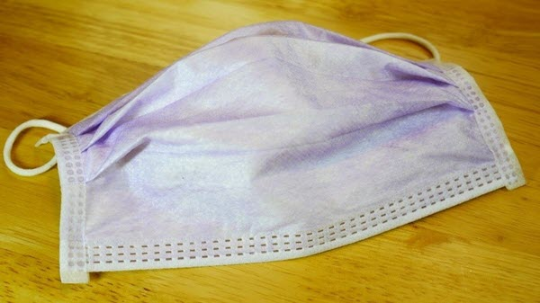
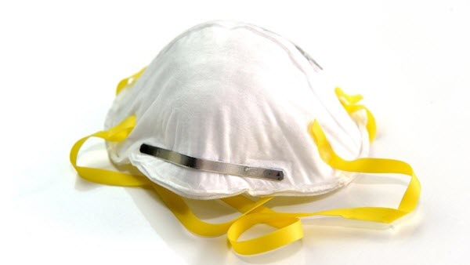
Types of Masks
surgical mask
intended to keep the wearer from spraying droplets onto others
respirator
intended to reduce the wearer’s exposure to inhaled particles
https://www.fda.gov/medical-devices/personal-protective-equipment-infection-control/n95-respirators-and-surgical-masks-face-masks

Slide 39
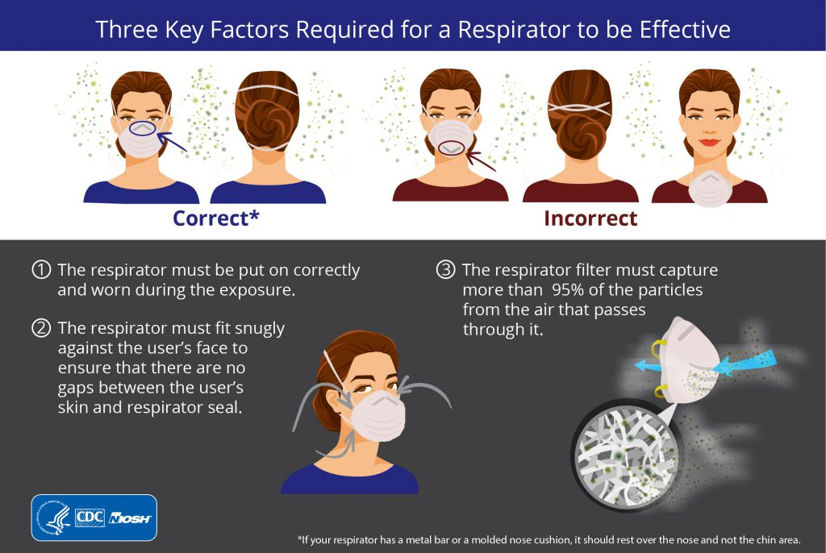
https://blogs.cdc.gov/niosh-science-blog/2018/01/04/respirators-public-use/

Slide 40
Filtration Mechanisms
Impaction
Interception
Diffusion
Not sieving!
“collector” = single fiber in a filter
Bulejko, 2018, Nanomaterials, https://www.mdpi.com/2079-4991/8/6/447/htm

Slide 41
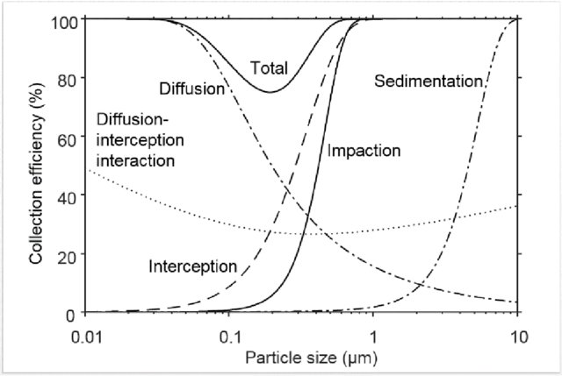
Filter Efficiency
minimum at 0.1-0.3 µm, where no collection mechanism works well
Lindsley, 2016, NIOSH Manual of Analytical Methods, https://www.cdc.gov/niosh/nmam/default.html

Slide 42
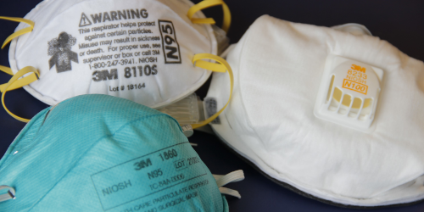
N95
Blocks at least 95% of particles of diameter 0.3 µm
Removal efficiency is even better for particles >0.3 µm and particles <0.3 µm
Capture efficiency depends on the size and density of the particle and should be the same whether the particle contains a virus or not
https://www.cdc.gov/niosh/npptl/default.html

Slide 43
Surgical Masks and Flu Virus
Different types of surgical masks reduced the amount of infectious flu virus measured behind the mask on a manikin by an average of a factor of 6 (range 1.1-55).
Booth et al., 2013, J. Hosp. Infection, https://www.ncbi.nlm.nih.gov/pubmed/23498357

Slide 44
What do we know about SARS-CoV-2 in droplets/aerosols?

Slide 45
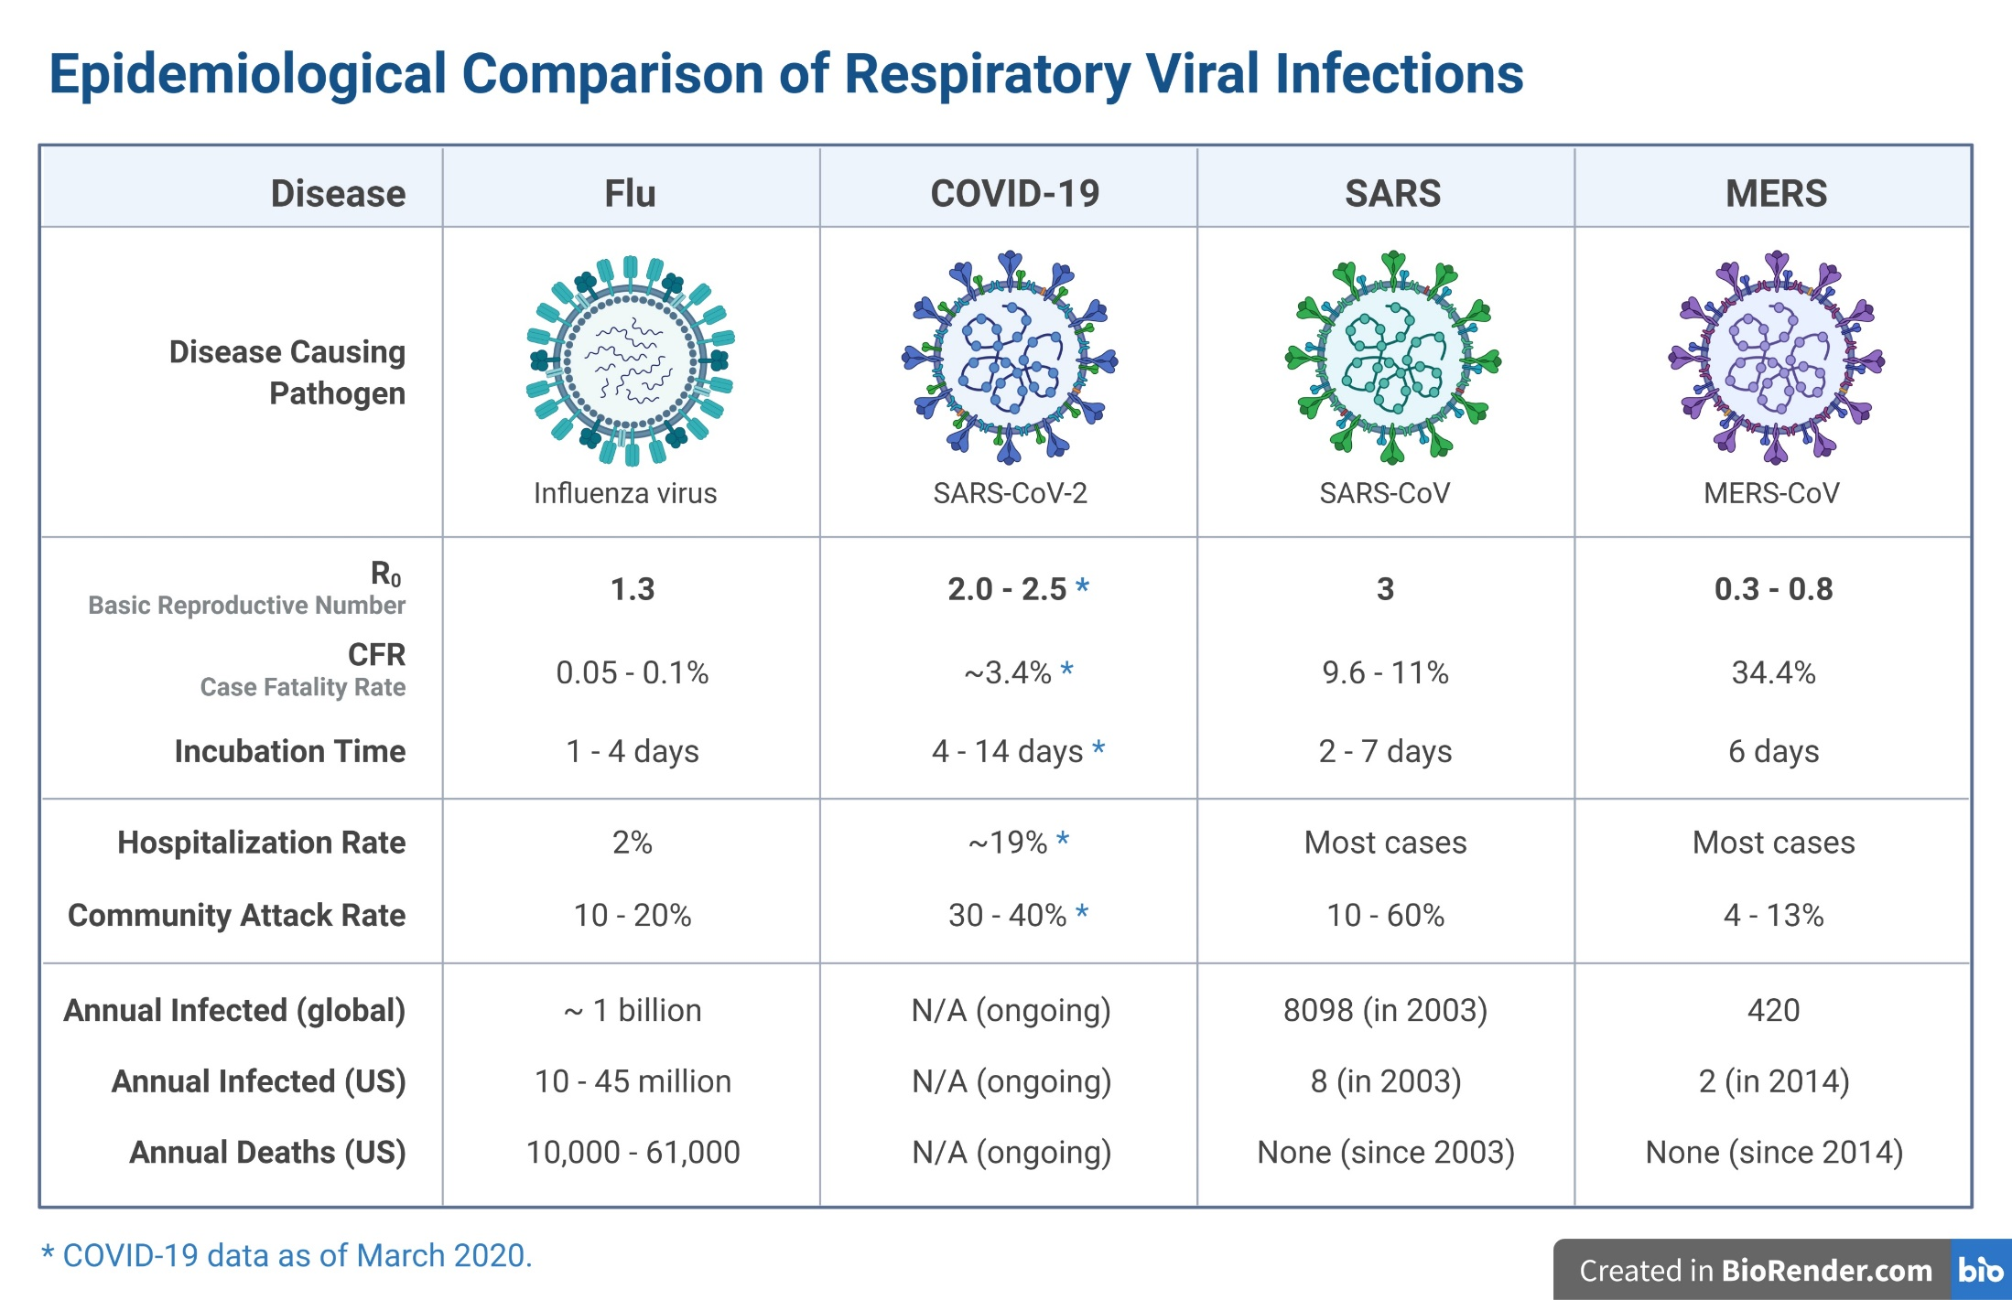
https://twitter.com/VirusesImmunity/status/1238475009712160769

Slide 46
positive
table, bed rail, locker, chair, light switches, stethoscope, sink, floor, window, door and handle, toilet, air outlet fan
negative
Samples in patient A’s and B’s rooms were negative after cleaning. These results are for patient C before cleaning.
control panel on bed, call bell, rail in bathroom, outer rim of sink in bathroom, all anteroom, air
Ong et al., 2020, JAMA, https://jamanetwork.com/journals/jama/fullarticle/2762692
Notes:
How could air samples be negative if virus was found on the outlet fan? Probably high ventilation rate led to low concentrations. Air sample volume was 1.2 m³, a small fraction of total room air. Virus aerosols in warm plume that rose over sampler?

Slide 47
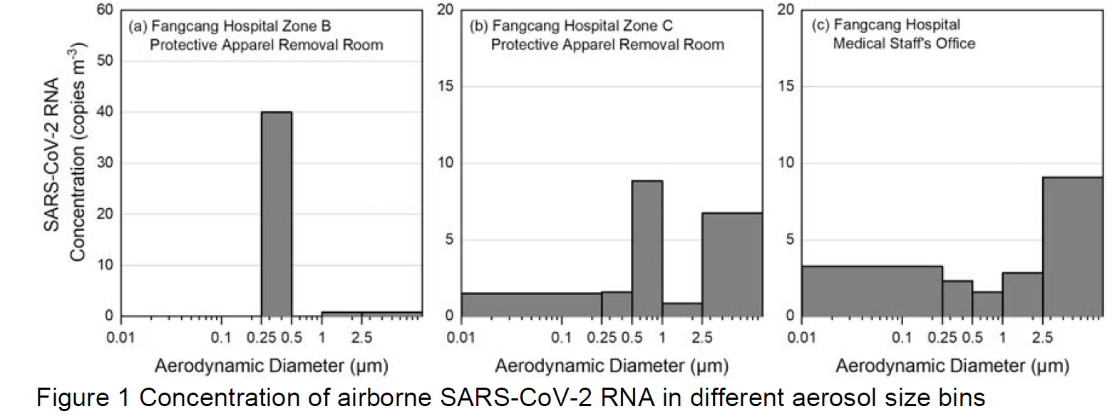
SARS-CoV-2 Size Distributions
Liu et al., 2020, preprint, https://doi.org/10.1101/2020.03.08.982637

Slide 48
SARS-CoV-2 Survival in Aerosols
van Doremalen et al., 2020, NEJM, https://www.nejm.org/doi/full/10.1056/NEJMc2004973

Slide 49
Major Unknowns
Which transmission route
is dominant: direct contact,
indirect contact with
contaminated objects (fomites), inhalation of aerosols, deposition of droplets?
How are viruses inactivated in air and on surfaces?
How much virus is released in what size aerosols at different stages of infection?
How well does SARS-CoV-2 survive in aerosols under real-world conditions?
Liu et al., 2016, Indoor Air, https://onlinelibrary.wiley.com/doi/abs/10.1111/ina.12314

Slide 50















Acknowledgments
Karen Kormuth
Seema Lakdawala
Weinan Leng
Kaisen Lin
AJ Prussin II
Elankumaran Subbiah
Eric Vejerano
Peter Vikesland
Haoran Wei
Wan Yang
Notes:
National Nanotechnology Coordinated Infrastructure

